Slide 1




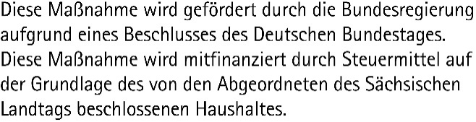
TRAINING: Data Science and AI for Medicine Training School 2026 Day 1: Python and Tools – AI Assistants in JupyterLab
SPEAKER: Matthias Täschner
Using materials from Robert Haase (DSC ScaDS.AI / Leipzig University)
These slides may be reused under the terms of the CC-BY 4.0 license, unless otherwise specified.

Slide 2
LLM Services and Their Use What is an LLM?
Advanced AI models (neural networks/deep learning), which are trained on large amounts of text
Designed to “understand” and generate human language
Capable of incorporating context and interacting with users
Can perform a variety of tasks depending on their specialization:
Answering questions
Summarizing texts
Translating
Generating code
Other functions, e.g., web search

Slide 3
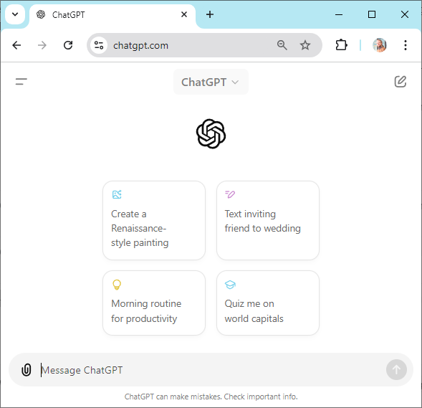
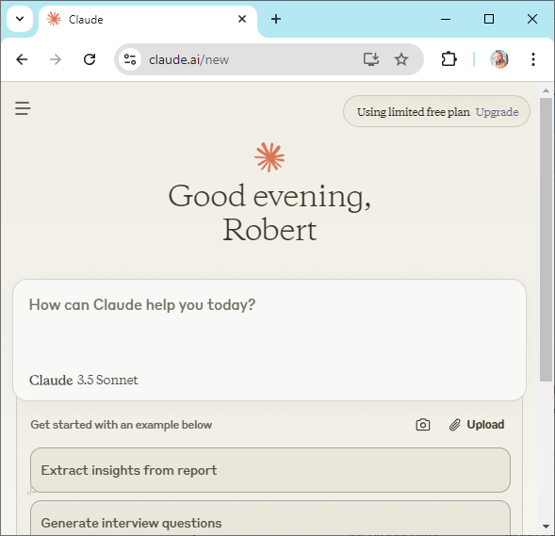
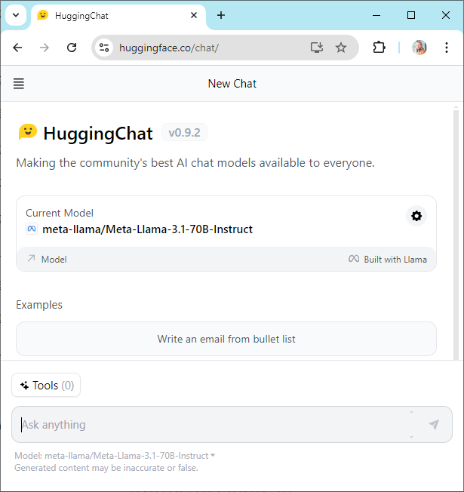
LLM Services and Their Use What is an LLM?
ChatGPT
Claude
Open models
https://chatgpt.com/
https://claude.ai/
https://huggingface.co/chat/

Slide 4
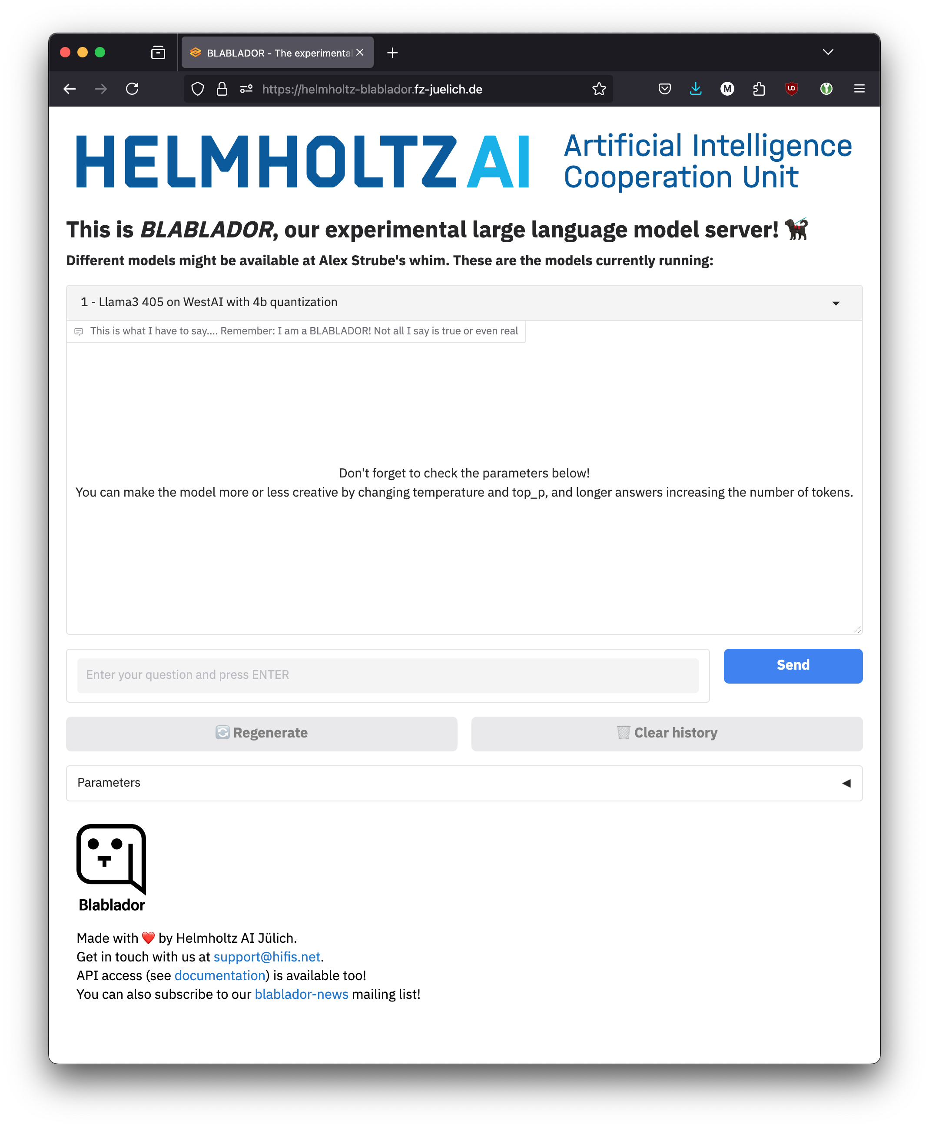
LLM Services and Their Use What is an LLM?
Helmholtz Blablador
Various providers with their own services and LLMs
Proprietary to open source
Paid to free of charge
Server locations worldwide, in Europe, in Germany
Basic technical structure and concepts are mostly similar
https://helmholtz-blablador.fz-juelich.de/

Slide 5




LLM Services and Their Use Setup and Usage
Browser
Provider Server
„Provider“
Login and Usage via User / Password
Web-
Service
with
Chat
LLM A
API Key stored on local PC
With active login: Create API Key
Login and Usage via API Key
LLM B
API
Code
Provider-ID/Model-ID

Slide 6
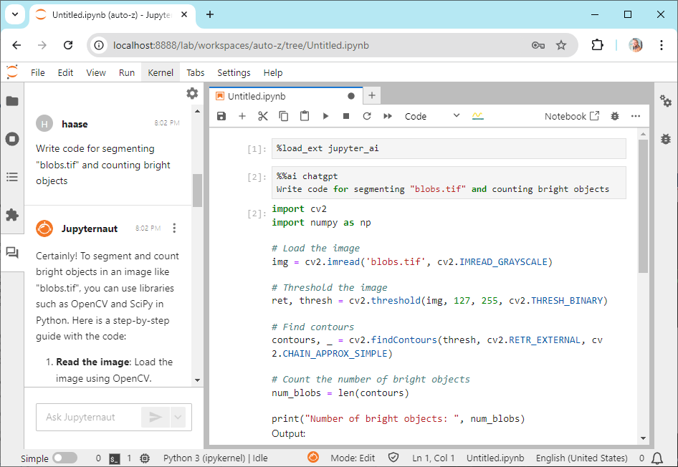
LLM Services and Their Use AI Assistants
Integration of LLM capabilities into existing tools and services
ChatBots on websites
AI assistant in MS365, Adobe Cloud, …
AI assistant in programming environments (IDE, etc.)
or Jupyter Lab, e.g., via “jupyter-ai” or “bia-bob“
Provider
Login with API Key
LLM A
API
blablador/alias-fast
LLM B
Software package or plugin for chat function, text/code generation, etc.
with connection to …
Local computer
Local LLM Service
API
LLM a
Alternatively:
local access, requires appropriately powerful hardware

Slide 7
LLM Services and Their Use AI Assistants
Prompt Engineering
Prompt: Instruction to the AI assistant/LLM to perform a task.
Formulate as precisely as possible and provide context.
Iterative modification of the prompt until the desired result is achieved.
Restrictions and limitations
Prompts and context are transferred to LLM – when using an external LLM service provider, this means to external servers → observe data protection regulations!
AI assistant is only as good as the LLM used – variation in quality of responses, available languages, knowledge level, code generation capability, etc.
The context window (number of tokens) has limits and varies depending on the LLM
As part of this training, we use
“bia-bob” (AI assistant for Jupyter) [https://github.com/haesleinhuepf/bia-bob]
LLM cluster of Leipzig University

